Slide 1
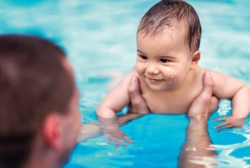
Celebrating Breastfeeding Week
October 2nd – October 6th
** Saturday
September 30th
Monday
Tuesday
Wednesday
Thursday
Friday
October 2nd
October 3rd
October 4th
October 5th
October 6th
Flag Raising
In front of the
Civic Centre
@ 11:30 am
PLUS
Mommy & Me Walk
1:30-3:30pm
PUBLIC
SWIM
Entry fee provided by the
Kapuskasing Breastfeeding Coalition
Donat Brousseau Pool
10:30-11:30
Radio Show!
Tune into Moose FM and CKGN to meet a coalition member and learn about our goals and fun projects!
Open House
with
Betsy Connor!
Drop-in anytime
between
10 am – 3 pm
CapC
Annual Breastfeeding Celebration
Ontario Early Years Centre
@ 10am
Mommy & Me Fitness
with
Kim Lemaire!
Breastfeeding Edition
Ontario Early Years Centre
@ 9:15-11:45am
14 Kolb Street
HELP US FIND KATE!
CONTEST: Visit us on Kapuskasing Celebrates Breastfeeding for details on how to enter a DRAW to WIN 200$ in prizes! The contest will close Friday, October 5th at NOON with the winner announced on Facebook at 3pm! ??How good are your DETECTIVE skills??

